Slide 1
Constitution Heights Metropolitan District
2023 Status

Slide 2
Structure of the District
District
Elected/Appointed Board of Directors
Professional Management by WSDM District Managers
Legal support as needed
Auditors

Slide 3
Operational Expenses
Management expenses include
Billing
Mailing
Accounting
Website
Special District compliance filings and other requirements
Customer interactions
Account transfer
Legal expenses include
Support as needed
Auditors
Insurance

Slide 4
Current Public Infrastructure Projects
There are currently no public infrastructure projects within the District.

Slide 5
Current Bond Status
CONSTITUTION HEIGHTS METROPOLITAN DISTRICT
Bond Amounts | Lender/Trustee | Interest Rate | Issued | BALANCE AS OF 12/31/2023
Series 2020: $12,335,000
Maturity Date: Dec. 1, 2049 | UMB BANK | 5% | 6/9/2020 | 12,335,000.00

Slide 6
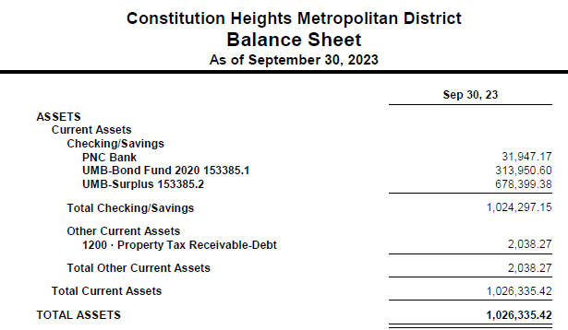
Unaudited Financial Statements Balance Sheet- As of September 30, 2023

Slide 7
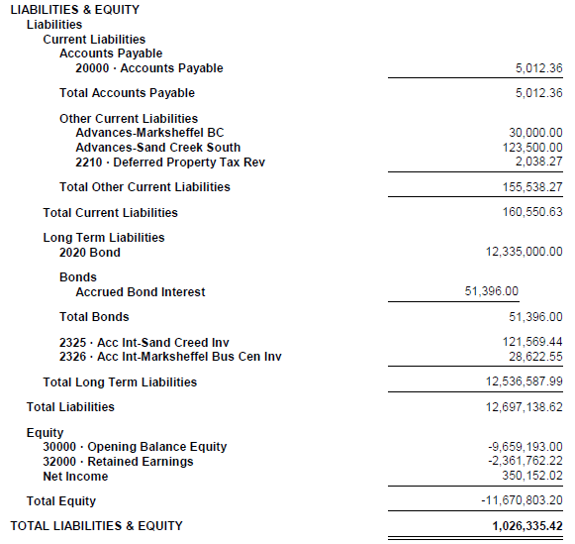
Balance Sheet- As of September 30, 2023 (CONT’D)

Slide 8
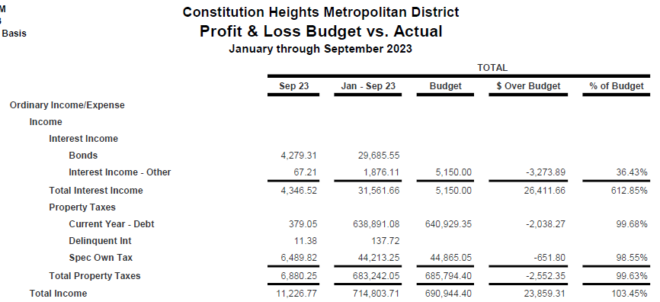
Unaudited Financial Statements Profit & Loss 2023 Budget vs. Actual – As of September 30, 2023

Slide 9
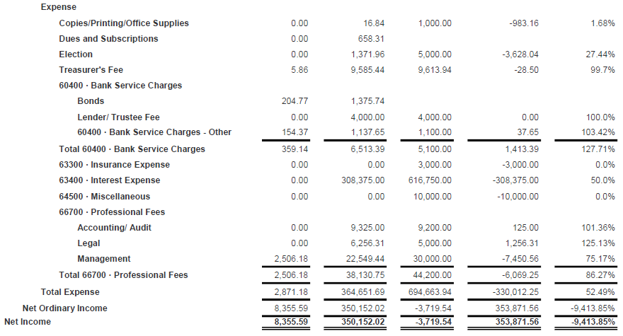
Profit & Loss 2023 Budget vs. Actual – As of September 30, 2023 (CONT’D)

Slide 10
Questions?

